Slide 1


Ângelo Pinto
14-1

Slide 2

Outline
Executive Summary
Introduction
Methodology
Results
Conclusion
Appendix

Slide 3
Executive Summary
Summary of methodologies:
Data Collection using web scraping and SpaceX API;
Exploratory Data Analysis (EDA), including data wrangling, data visualization and interactive visual analytics;
Machine Learning Prediction.
Summary of all results:
Succeeded in collecting valuable data from public sources;
The best features to predict success of launchings of found through EDA;
Machine Learning Prediction showed the best model to predict which characteristics are important to drive this opportunity, using all collected data

Slide 4
Introduction
Project background:
The objective is to evaluate the viability of the new company Space Y to compete with Space X.
Desirable answers:
The best way to estimate the total cost for launches, by predicting successful landings of the first stage of rockets;
• Where is the best place to make launches.

Slide 5

Section 1

Slide 6
Methodology
Executive Summary
Data collection methodology:
WebScraping
SpaceX API https://api.spacexdata.com/v4/rockets/
Perform data wrangling
Collected data was enriched by creating a landing outcome label based on outcome data after summarizing and analyzing features
Perform exploratory data analysis (EDA) using visualization and SQL
Perform interactive visual analytics using Folium and Plotly Dash

Slide 7
Methodology
Executive Summary
Perform predictive analysis using classification models
At this step previously collected data was normalized and split into a training and test set. Then 4 machine learning algorithms were trained and tested. The best algorithm was evaluated using accuracy score.

Slide 8
Data Collection
Data sets were collected from Space X API (https://api.spacexdata.com/v4/rockets/) and from Wikipedia (https://en.wikipedia.org/wiki/List_of_Falcon/_9/_and_Falcon_Heavy_launches), using web scraping technics.

Slide 9
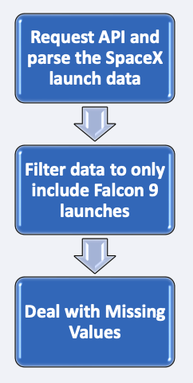
Data Collection – SpaceX API
SpaceX offers a public API. Data was obtained and used from that API;
This API was used according to the flowchart on the right and then data was persisted.
Place your flowchart of SpaceX API calls here

Slide 10
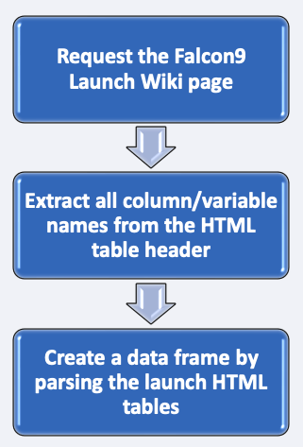
Data Collection - Scraping
Data from SpaceX can also be obtained through WebScraping, according to the chart on the right
Place your flowchart of web scraping here

Slide 11
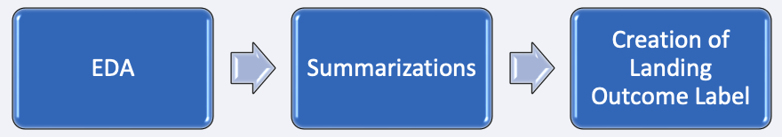
Data Wrangling
At first, Exploratory Data Analysis (EDA) was performed on the dataset.
Then the summaries launches per site, occurrences of each orbit and occurrences of mission outcome per orbit type were calculated.
Finally, the landing outcome label was created from Outcome column.

Slide 12
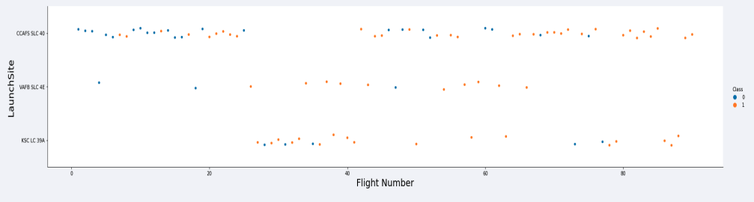
EDA with Data Visualization
To explore data, scatterplots and barplots were used to visualize the relationship between pair of features:
Payload Mass X Flight Number, Launch Site X Flight Number, Launch Site X Payload Mass, Orbit and Flight Number, Payload and Orbit

Slide 13
EDA with SQL
The following SQL queries were performed:
Names of the unique launch sites in the space mission;
Top 5 launch sites whose name begin with the string 'CCA’;
Total payload mass carried by boosters launched by NASA (CRS);
Average payload mass carried by booster version F9 v1.1;
Date when the first successful landing outcome in ground pad was achieved;
Names of the boosters which have success in drone ship and have payload mass between 4000 and 6000 kg;
Total number of successful and failure mission outcomes;

Slide 14
EDA with SQL
The following SQL queries were performed:
Names of the booster versions which have carried the maximum payload mass; •
Failed landing outcomes in drone ship, their booster versions, and launch site names for in year 2015; and •
Rank of the count of landing outcomes (such as Failure (drone ship) or Success (ground pad)) between the date 2010-06-04 and 2017-03-20.

Slide 15
Build an Interactive Map with Folium
Markers, circles, lines and marker clusters were used with Folium Maps
Markers indicate points like launch sites;
Circles indicate highlighted areas around specific coordinates, like NASA Johnson Space Center;
Marker clusters indicates groups of events in each coordinate, like launches in a launch site; and
Lines are used to indicate distances between two coordinates.

Slide 16
Build a Dashboard with Plotly Dash
The following graphs and plots were used to visualize data
Percentage of launches by site
Payload range
This combination allowed to quickly analyze the relation between payloads and launch sites, helping to identify where is best place to launch according to payloads.

Slide 17
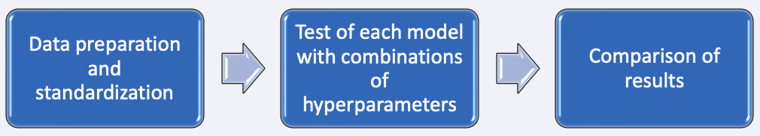
Predictive Analysis (Classification)
Four classification models were compared: logistic regression, support vector machine, decision tree and k nearest neighbors.
Source code: https://github.com/1120249/data_science_ibm/blob/master/Tesla_ML_Prediction.ipynb

Slide 18
Results
Exploratory data analysis results:
Space X uses 4 different launch sites;
The first launches were done to Space X itself and NASA;
The average payload of F9 v1.1 booster is 2,928 kg;
The first success landing outcome happened in 2015 fiver year after the first launch;
Many Falcon 9 booster versions were successful at landing in drone ships having payload above the average;
Almost 100% of mission outcomes were successful; •
Two booster versions failed at landing in drone ships in 2015: F9 v1.1 B1012 and F9 v1.1 B1015; •
The number of landing outcomes became as better as years passed.

Slide 19

Section 2

Slide 20
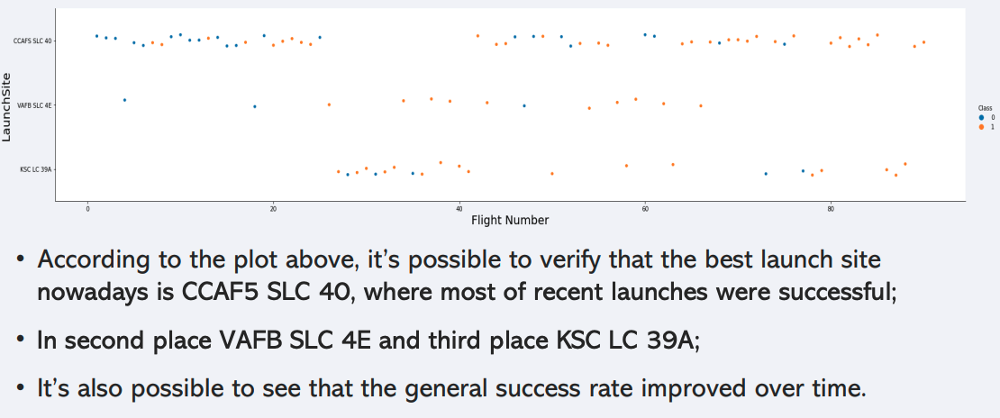
Flight Number vs. Launch Site

Slide 21
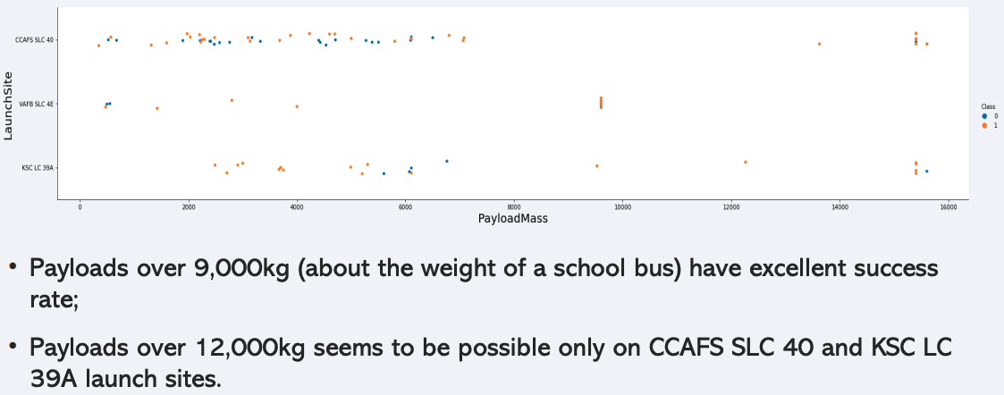
Payload vs. Launch Site

Slide 22
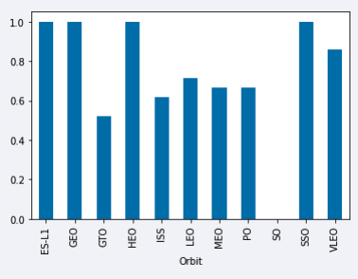
Success Rate vs. Orbit Type
The biggest success rates happens to orbits:
ES-L1;
GEO;
HEO; and • SSO.
Followed by:
VLEO (above 80%); and LFO (above 70%).

Slide 23
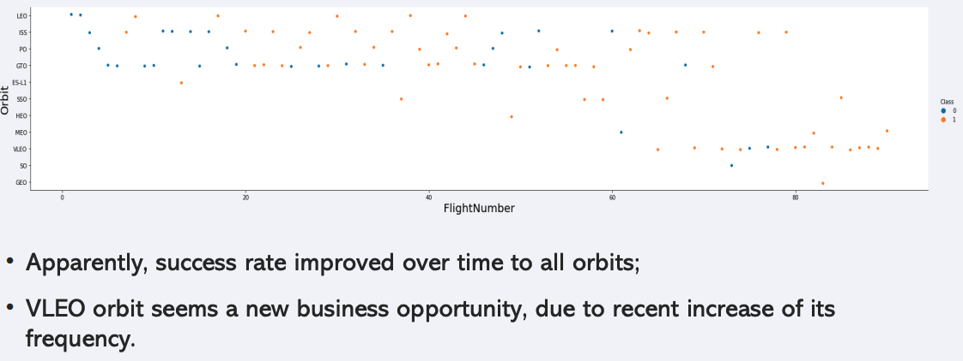
Flight Number vs. Orbit Type

Slide 24
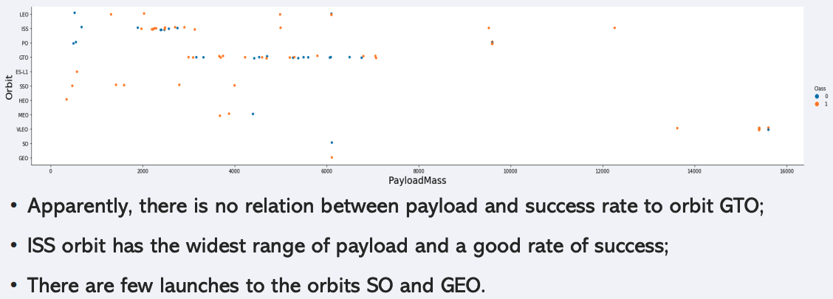
Payload vs. Orbit Type

Slide 25
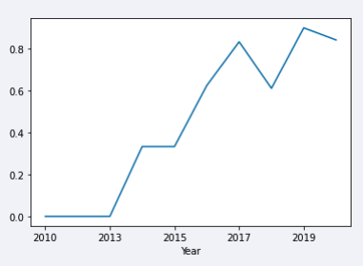
Launch Success Yearly Trend
Success rate started increasing in 2013 and kept until 2020;
It seems that the first three years were a period of adjusts and improvement of technology.

Slide 26
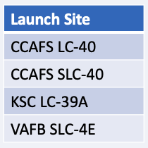
All Launch Site Names
According to data, there are four launch sites:
They are obtained by selecting unique occurrences of “launch_site” values from the dataset.

Slide 27
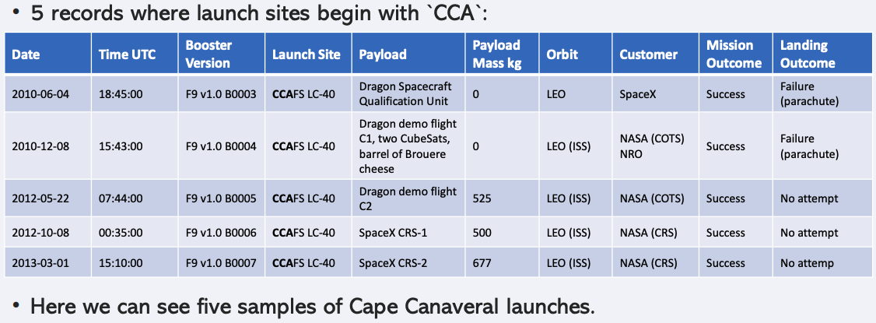
Launch Site Names Begin with 'CCA'

Slide 28
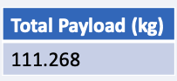
Total Payload Mass
Total payload carried by boosters from NASA:
Total payload calculated above, by summing all payloads whose codes contain ‘CRS’, which corresponds to NASA.

Slide 29
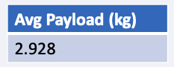
Average Payload Mass by F9 v1.1
Average payload mass carried by booster version F9 v1.1:
Filtering data by the booster version above and calculating the average payload mass we obtained the value of 2,928 kg.

Slide 30
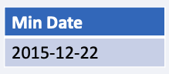
First Successful Ground Landing Date
First successful landing outcome on ground pad:
By filtering data by successful landing outcome on ground pad and getting the minimum value for date it’s possible to identify the first occurrence, that happened on 12/22/2015.

Slide 31
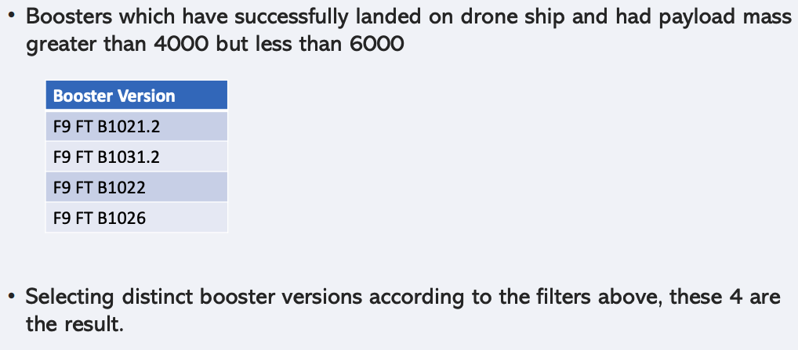
Successful Drone Ship Landing with Payload between 4000 and 6000

Slide 32
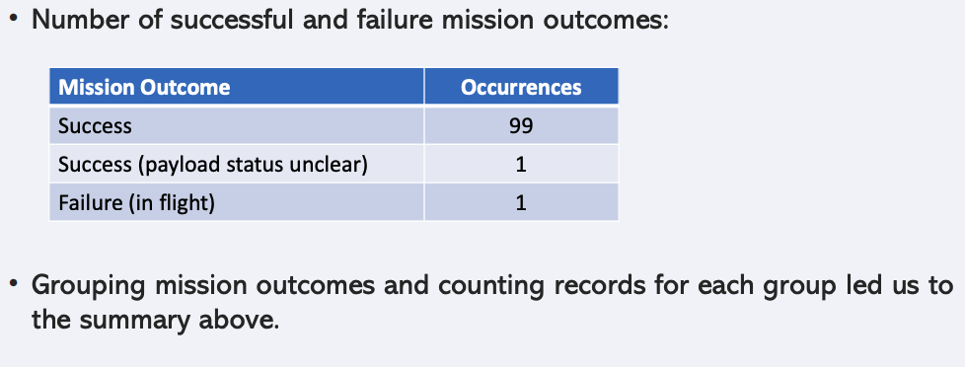
Total Number of Successful and Failure Mission Outcomes

Slide 33
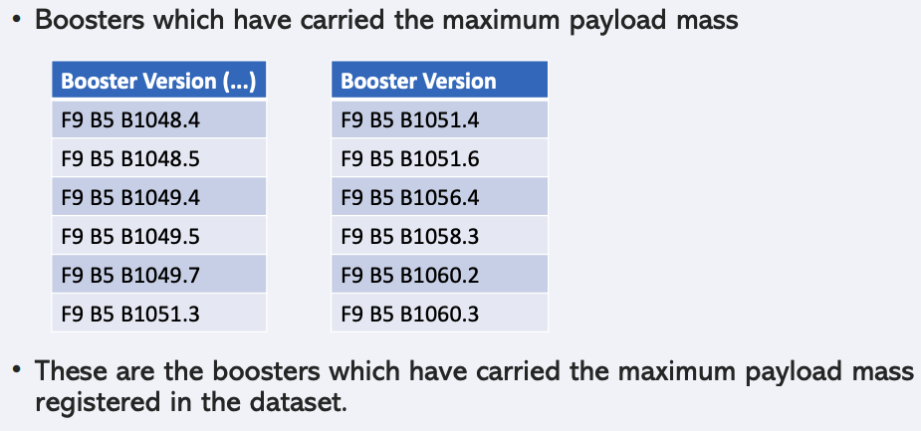
Boosters Carried Maximum Payload

Slide 34
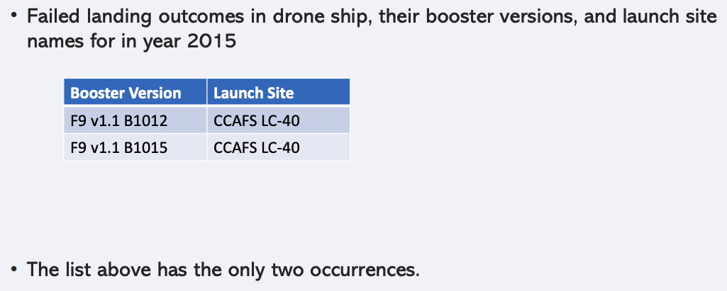
2015 Launch Records

Slide 35
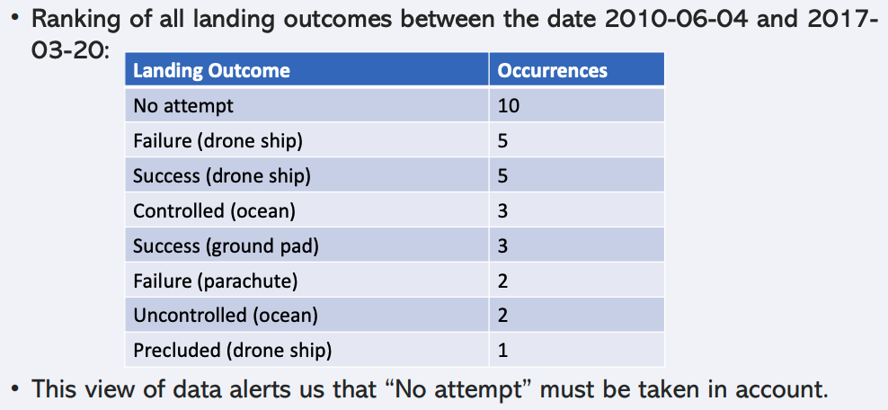
Rank Landing Outcomes Between 2010-06-04 and 2017-03-20

Slide 36

Section 3

Slide 37
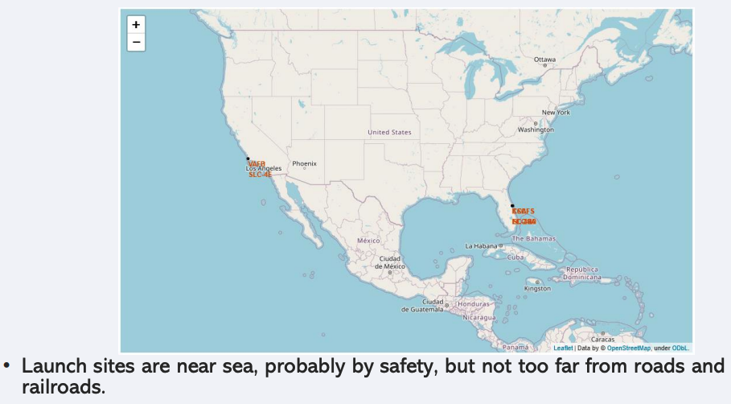
Launch sites

Slide 38
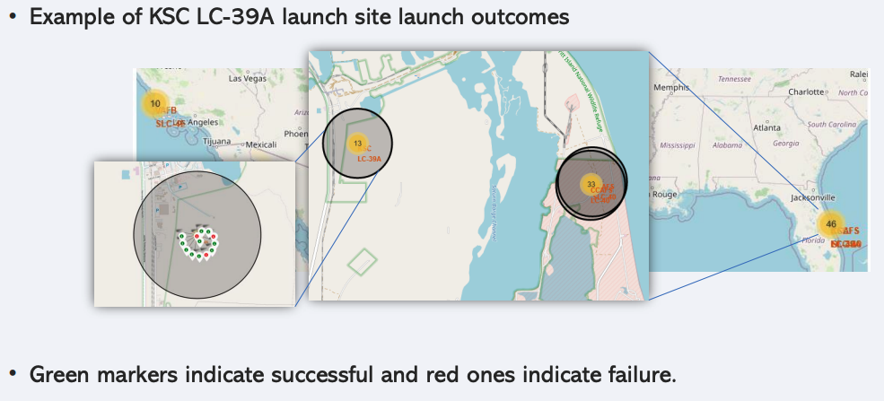
Launch outcomes by site

Slide 39
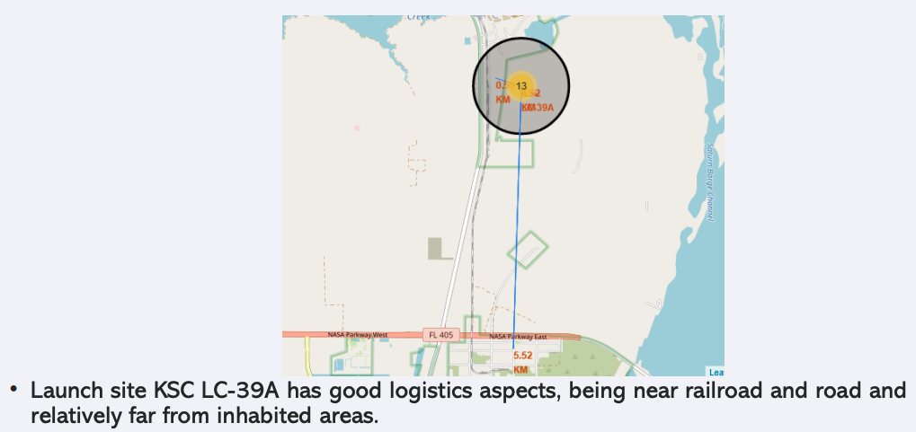
Logistics and Safety

Slide 40

Section 4

Slide 41
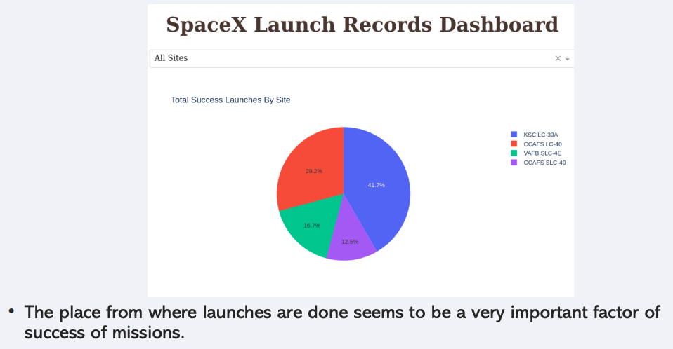
Successful Launches by Site

Slide 42
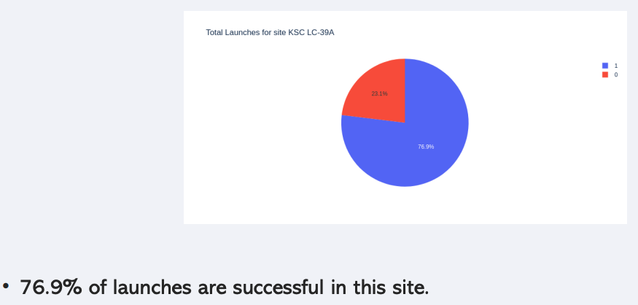
Launch Success Ratio for KSC LC-39A

Slide 43

Section 5

Slide 44
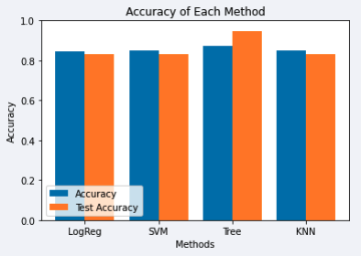
Classification Accuracy
Four classification models were tested, their accuracies are plotted on the right;
The model with the highest classification accuracy was Decision Tree Classifier, with accuracies over 87%.

Slide 45
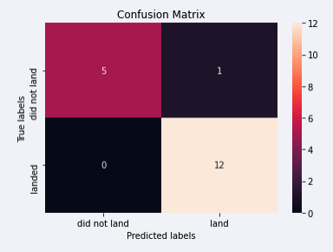
Confusion Matrix
Confusion matrix of Decision Tree Classifier proves its accuracy by showing the big numbers of true positive and true negative compared to the false ones.

Slide 46
Conclusions
Different data sources were analyzed, refining conclusions along the process;
The best launch site is KSC LC-39A;
Launches above 7,000kg are less risky;
Although most of mission outcomes are successful, successful landing outcomes seem to improve over time, according the evolution of processes and rockets;
Decision Tree Classifier can be used to predict successful landings and increase profits.

Slide 47
Appendix
As an improvement for model tests, it’s important to set a value to np.random.seed variable;

Slide 48


